Slide 1


Corporate Integrity System (CIS)
Ms. Sophia Aspesi Areias, Business Integrity Programme Manager
Transparency International Cambodia

Slide 2

Content
CPI
CIS
GCB
BIP

Slide 3
Introduction
BIP initiated in January 2014
  Global movement
  Regional network
What We Do
  Corporate integrity System
  Services/Trainings on for example the legal framework, taxation, procurement, public service fees and anti-bribery principles
  Research – SME Corruption Perception, Case Study on Taxation, Business briefs
General objective: Reduced corruption through improved transparency, integrity and accountability in business practices.
Approach: Three levels: Individual companies, groups of companies and business environment
Notes:
Keywords: 100 chapters, TI-M, TT-Vietnam, TI-Indonesia,

Slide 4


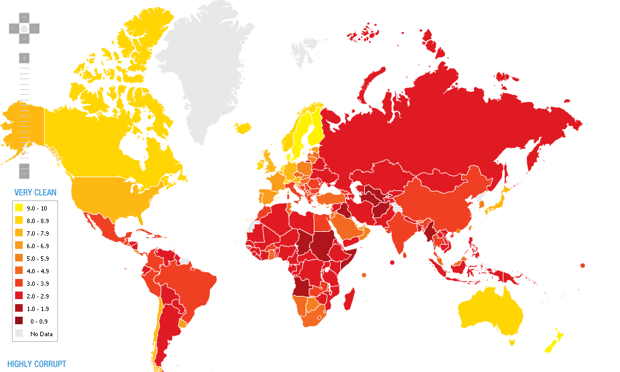
សន្ទស្សន៍នៃការយល់ឃើញអំពើពុករលួយគឺ៖
1. Corruption Perceptions Index (CPI) – ASEAN
Ranks more than 170 countries in terms of perceived levels of public
sector corruption, as determined by expert assessments and opinion surveys
CPI 2015: THE BOTTOM 10
CPI 2016 for ASEAN
Ranking: 156/176
2

Slide 5

2. Global Corruption Barometer 2016 - Cambodia
Perception of corruption, by institution - proportion that think most or all are corrupt – Cambodia

Slide 6
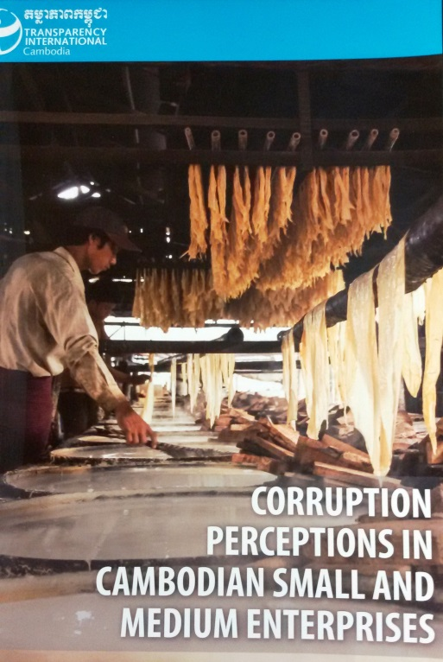

3. SME Research Findings
22% preferred not to talk about corruption or said that they were not able to define corruption
47% said that they have heard of or experienced corruption issues
57% think that corruption is one of the external factor impeding their company’s progress
40% had to pay unofficial fees in connection with inspections while 30% did not have to pay anything.
63% have never discussed business integrity in their company

Slide 7
Conclusion of Findings
Cambodia is an environment with a high corruption risk
Low trust in public institutions
Low level of transparency combined with complicated bureaucratic procedures
Necessary to have a strong internal system to prevent corruption (Corporate Integrity System)

Slide 8
What is RISK?
Risk is defined as circumstances or factors which can have a negative impact on the operations or profitability of your business.
Generally classified as internal and external
An internal risk involves circumstances or events within your organization
An external risk involves circumstances or events outside your business, in the larger environment.

Slide 9
Corruption as a RISK
Convictions fines and prison sentences for employees and officers.
Significant reputational damage
Loss of shareholders
Loss of investors
Higher costs
Unpredictability of prices

Slide 10
Legal Framework
Bribery is illegal under the:
Cambodian Law on Anti-Corruption
UK Anti-Bribery Act
Foreign Corrupt Practices Act (USA)

Slide 11
Mitigating Corruption Risks
Ways to help mitigate your company’s risk :
Strong internal policies
Careful vetting of partners i.e. supplies, contractors etc.
Integrity Pacts

Slide 12
What is a corporate integrity system (CIS?)
4. Corporate Integrity Systems (CIS)
Essential component for ensuring business integrity.
Creates an internal governance structure that limits the possibilities for nepotism, conflict of interest, and corruption.
Set of policies and procedures for a variety of topics that may put your company at risk for corruption.

Slide 13

Benefits of CIS
Reduces costs to business.
Clear trainings for staff, managers, and directors.
Clear policies and procedures that staff can consult.
In line with international standards.
Attractive to clients and investors

Slide 14
Key Areas of Concern
1. Gifts and Hospitality
3. Conflict of Interest
5. Whistleblowing
2. Facilitation Payment
4. Charitable Donations and Sponsorship
6. Personal Integrity Statement or Anti-Corruption Pledge
7. Integrity Pact

Slide 15
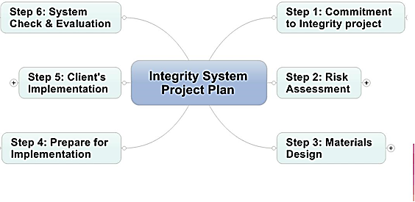
CIS Process
9

Slide 16
Interested in CIS?
In 2018, CIS is completely free, but we can only take a limited number of companies.
Sign up with our BIP team today and take the online assessment.

Slide 17
Interested in CIS for your company?
Contact us:
Sophia Aspesi Areias
Programme Manager
sophiaaspesiareias@ticambodia.org
Ms. Chhay Pidor
Senior Programme Officer
pidorchhay@ticambodia.org
Contact TI Cambodia
Set up a meeting
Assessment
Implementation

Slide 18
Thank you!
13

